Slide 1


Department of Computer Science & Engineering
End-Sem Evaluation Mini Project : CS-604
Scream Detection and Alert System
A CNN Model for Real-Time Audio Analysis and Location Based SMS Alerts
g
Team:
Eslavath Aditya (UI22CS24)
Doddapneni Dhanush (UI22CS21)
Kondeti Lara Praneeth (UI22CS38)
Under the guidance of
Ms. Jiby C
May, 2025

Slide 2
TABLE OF CONTENTS
Problem Statement
Current Scenario
Objective
Literature Survey
Proposed System and Methodology
Data Flow – DFD Diagram
Technology Stack for Model Building
Technology Stack for Android App
Android App Integration
Android App UI
Website UI
Validation
Current Challenges
Future Enhancements
Conclusion
References

Slide 3
Problem Statement
Emergency situations often go unnoticed, resulting in delayed response and potential harm.
Existing solutions may struggle with:
Detecting distress screams accurately in noisy environments.
Providing real-time alerts with precise location details.
A reliable system that identifies screams and alerts emergency contacts is essential for improving safety.

Slide 4
Current Scenario
Public safety is a growing concern in India, with crimes like harassment and assault happening frequently—one crime against women every 3 minutes, a kidnapping every 8 minutes, and a violent crime every 2 minutes. While scream detection systems exist, most lack real-time alerts and accurate location tracking. Our system fills this gap by detecting distress screams and instantly sharing the victim’s location, enabling faster assistance and aiming to make India safer.

Slide 5
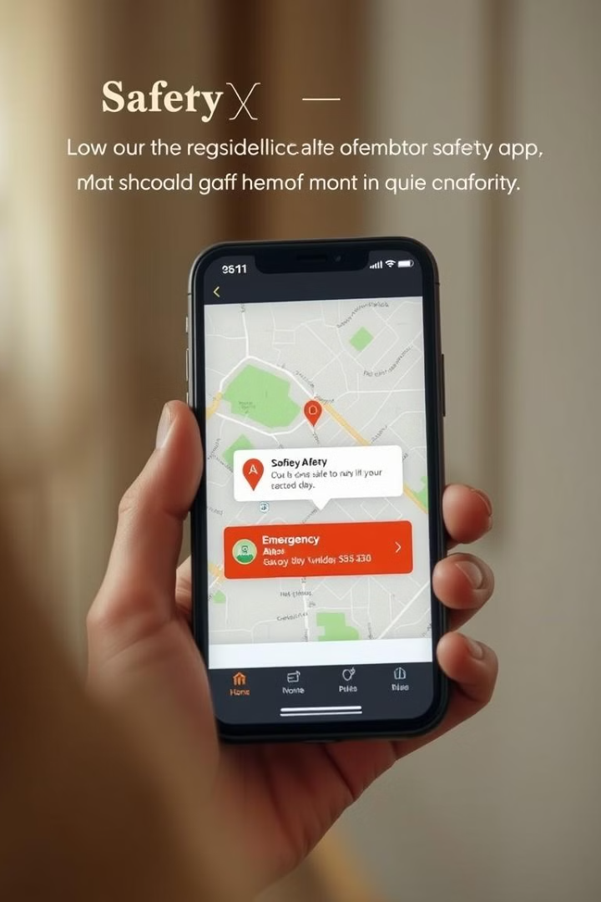
Objective
Develop and evaluate a robust scream detection system.
Integrate real-time audio processing and location tracking to enable emergency response.
Design a user-friendly Android application.
Design a Webpage where users can download our application.
Figure 1.1: Sample Illustration of an Alert Message Displayed on the phone

Slide 6
Literature Survey
Publication Identifiers | Authors | Year | Title | Algorithms | Research Gap
IJACSA: Vol. 9, No. 8, 2018 | Yusnita Yusof, Aini Hussain, Mohd Marzuki Mustafa, Mohd Zikri Razak | 2018 | A Review on Scream Classification for Situation Understanding | Support Vector Machines (SVM), Deep Neural Networks (DNN), Hidden Markov Models (HMM) | No alert mechanism Lacks real-time listening and location tracking
MDPI: 2076-3417 | Abdulaziz Alhujaili, Fahad S, Md Aldossari, Hussain M. Alharbi | 2021 | An Initial Machine Learning-Based Victim's Scream Detection in Fire Emergencies | Support Vector Machines (SVM), Long Short-Term Memory (LSTM) | No integrated alert system for emergency response, No location tracking for victims
ISSN : 1906-9685 | Dr.A.Shiva Kumar, P.Manogna Reddy, Akshitha, G.Sowmya | 2024 | Human Scream Detection Using SVM and MLP | Support Vector Machine (SVM), Multilayer Perceptron (MLP) | No SMS alert system integrated No location retrieval mechanism Requires manual monitoring instead of automated notifications

Slide 7
Literature Survey
Publication Identifiers | Authors | Year | Title | Algorithms | Research Gap
ISSN: 2250-0588 | Dr. P. K. Venkateswara Lal, Ch. Sai Sowmya | 2024 | Human Scream Detection and Analysis for Controlling Crime Rate | Support Vector Machines (SVM), Convolutional Neural Networks (CNN) | No automated alert system, No location-sharing capabilities
arXiv: 2411.03016 | Bikalpa Gautam, Anmol Guragain, Sarthak Giri | 2024 | Real-Time Scream Detection and Position Estimation for Worker Safety in Construction Sites | Wav2Vec2, Enhanced ConvNet, GCC-PHAT, Gradient Descent | No Alert mechanism, Complex setup for real-time deployment, Limited support for mobile device integration

Slide 8
Proposed System and Methodology
System Overview
"Our system captures audio data in real-time, processes it using a trained ML model, and triggers alerts with precise location details upon detecting a distress scream.“
Workflow Flow:
Audio Input
Feature Extraction
Model Prediction: Classifies sound as a distress scream or non-distress sound.
Alert System: If a scream is detected, sends an SMS alert via Twilio API with location details.
Android App Integration

Slide 9
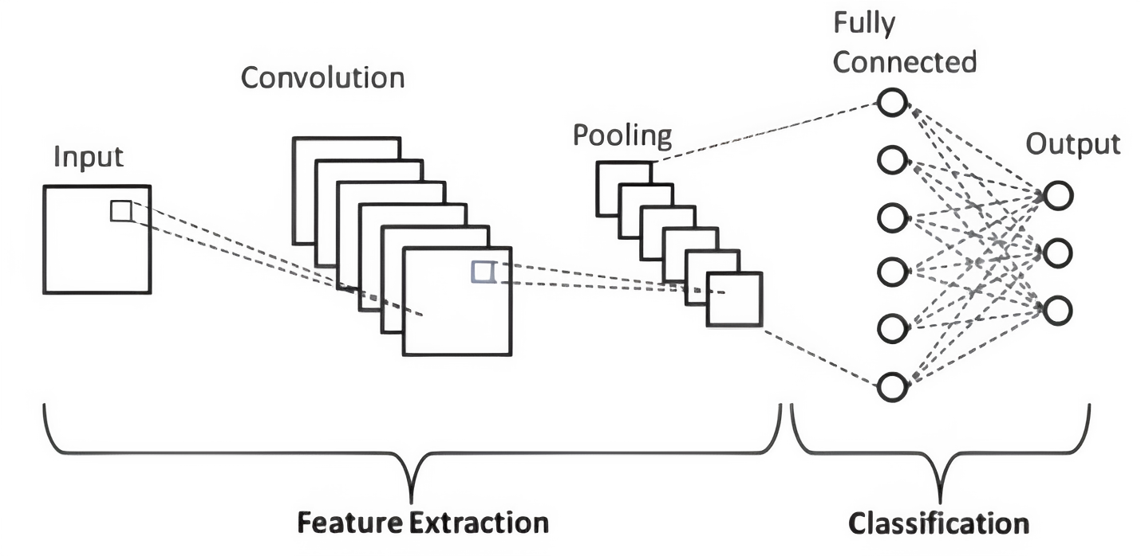
CNN Architecture for Scream Detection
Convolutional Layers
Extracts important audio features like MFCCs (Mel-Frequency Cepstral Coefficients).
Activation Functions
Adds non-linearity to detect complex audio patterns.
Pooling Layers
Reduces feature dimensions while retaining Information.
Fully Connected Layers
Combines extracted features to make final predictions.
Output Layer
Produces the final classification output: "Scream" or "No Scream".
Figure 1.2: Architecture of CNN

Slide 10
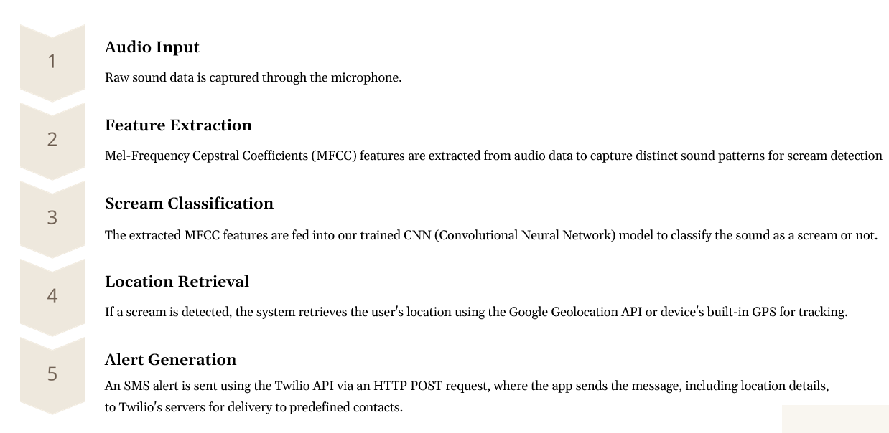
Data Flow

Slide 11
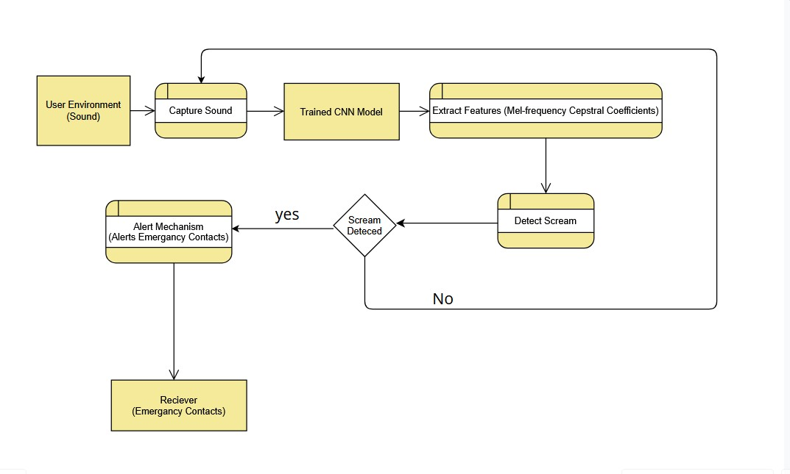
Work Flow Diagram:

Slide 12
Technology Stack For Model Building
Programming Language - Python
Machine Learning Framework -TensorFlow/Keras
Audio Processing - Librosa — Extracts MFCC (Mel-Frequency Cepstral Coefficients)
Alert System - Twilio API
Location Tracking - System GPS and Google Geolocation API
Android App Development - Java and Android Studio
Dataset – Kaggle & GitHub, classified as scream and no - scream 400 wav files each.

Slide 13
Technology Stack For Android App
Language: Java (Android SDK)
Platform: Android (min SDK 21+)
UI Framework: Android XML Layouts, RecyclerView
Media APIs: AudioRecord, MediaRecorder for real-time audio capture.
Permissions & System APIs: Runtime permissions (SEND_SMS, RECORD_AUDIO, ACCESS_FINE_LOCATION, POST_NOTIFICATIONS)
SMS: SmsManager (via SmsService)
UI Components: AlertDialog, Toast, EditText, Button, RecyclerView

Slide 14

Android App Integration
Wider Accessibility - Smartphones are common, ensuring the system is available to more users.
Real-Time Audio Monitoring - Uses the phone's microphone to detect distress sounds instantly.
On-Device ML Model - Deploys a lightweight TensorFlow Lite model for faster scream detection.
Location Tracking - Utilizes GPS to provide accurate location details.
Instant Alerts - Sends SMS alerts via Twilio API and inbuilt SMS system to emergency contacts.

Slide 15
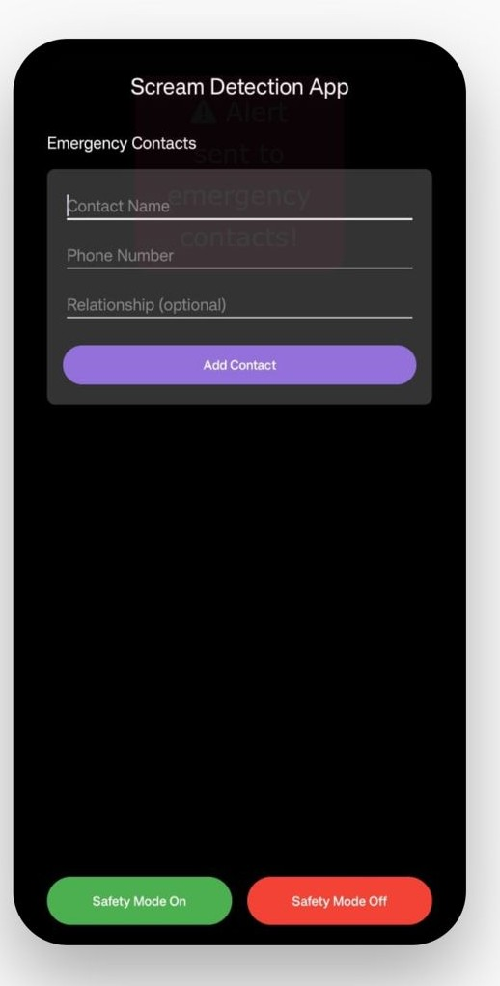
Android APP UI
Clean and minimal UI designed for ease of use.
Fields to add emergency contacts: name, phone number, and relationship.
"Add Contact" button in purple for quick saving.
Two large buttons:
Green: "Safety Mode On" – starts detection
Red: "Safety Mode Off" – stops detection
Dark theme improves focus and visibility in low-light settings.

Slide 16
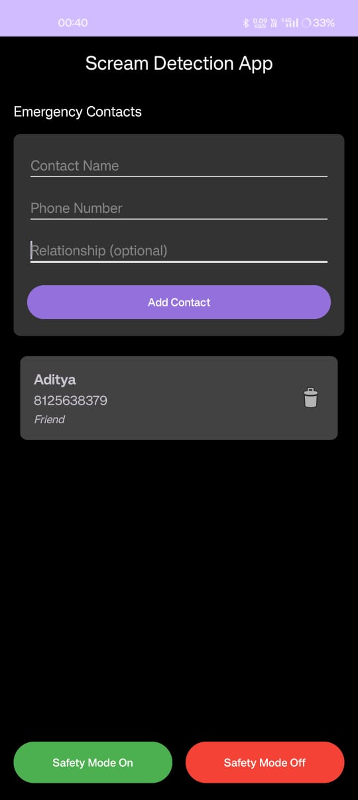
Android APP UI
Users can add up to 5 emergency contacts in the app
Saved contacts appear below the input form with:
Contact details
A trash icon to delete the contact if needed.

Slide 17
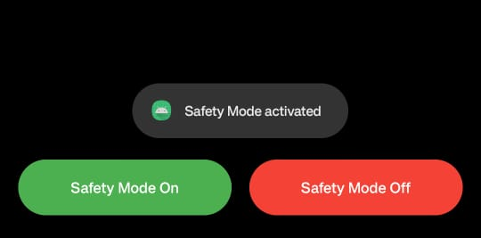
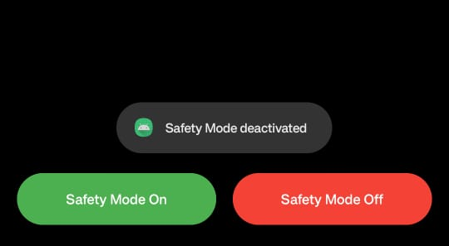
Android APP UI
Users can activate the scream detection system by turning Safety Mode On.
→ The app then runs in the background, continuously capturing and analyzing audio.
Users can deactivate the system by turning Safety Mode Off.
→ This will stop the background processing and pause scream detection.

Slide 18
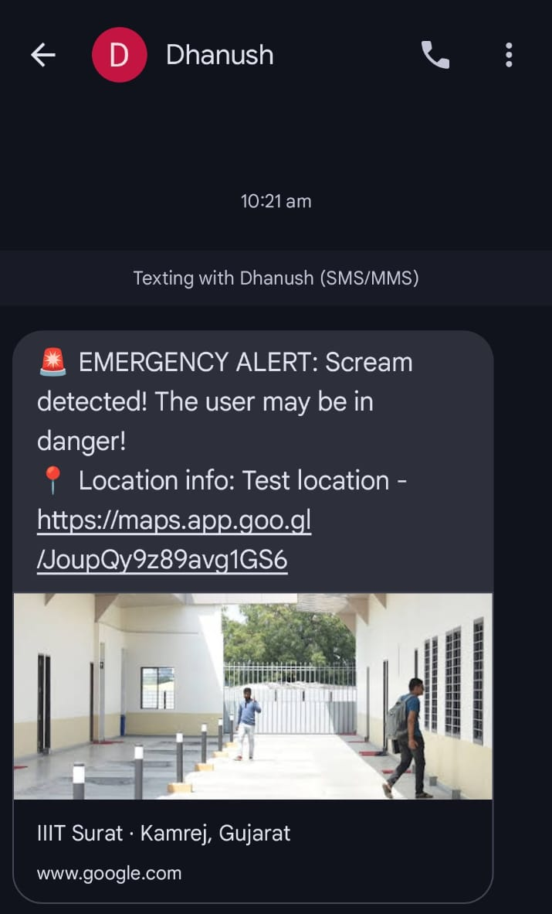
Alert Message
Automated alert SMS sent immediately after scream detection.
Message includes:
⚠️ Alert text: “Scream detected! The user may be in danger!”
📍 Location info with a Google Maps link to the user’s real-time position.
Image preview of the current location (if available).

Slide 19
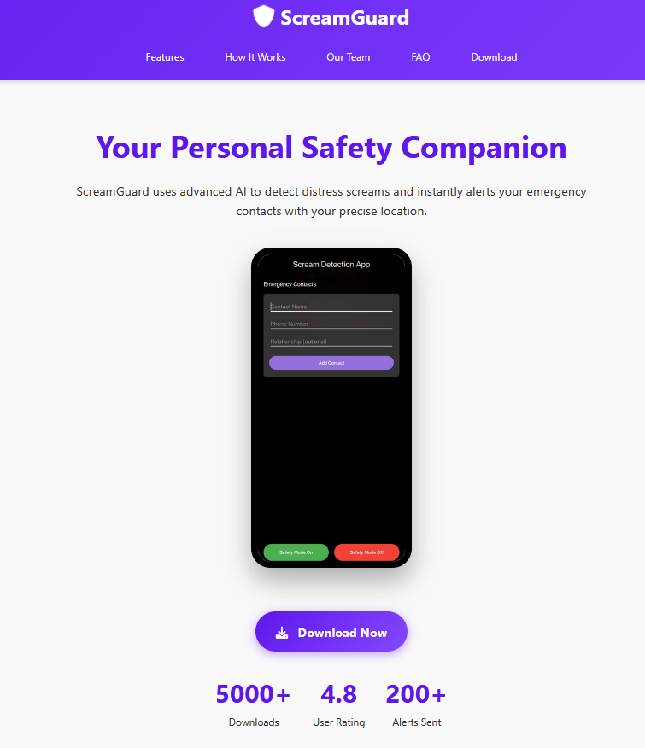
Website UI (App Download Page)
Hosted at: 🌐 https://screamguard.netlify.app/
Mobile-friendly design to ensure smooth experience across devices.
Includes a Download or Install button linking to the mobile app.

Slide 20
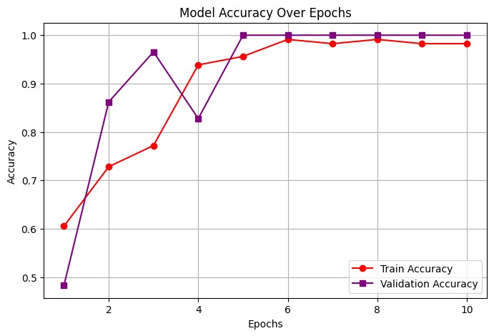
Validation
The following results highlight the model's accuracy in detecting screams under various conditions:
Figure 1.3: Graph Depicting Model Accuracy Across Epochs

Slide 21
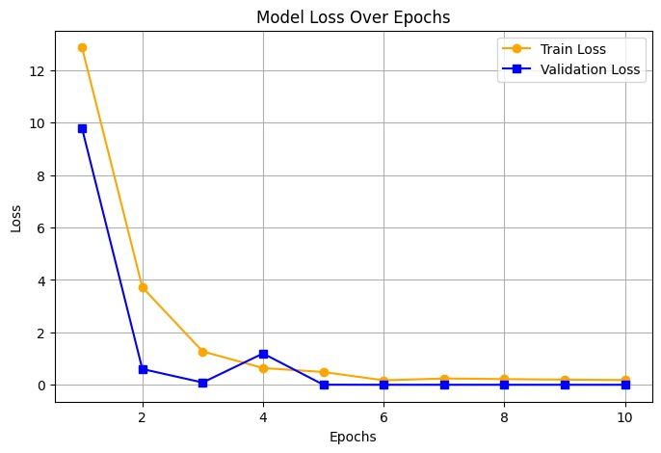
Validation
The following results highlight the model's accuracy in detecting screams under various conditions:
Figure 1.4: Graph Depicting Model Loss Across Epochs

Slide 22
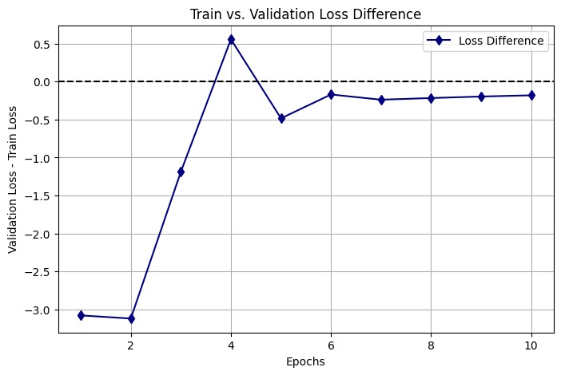
Validation
The following results highlight the model's accuracy in detecting screams under various conditions:
Figure 1.5: Graph Depicting Loss Difference Between Training and Validation Data

Slide 23
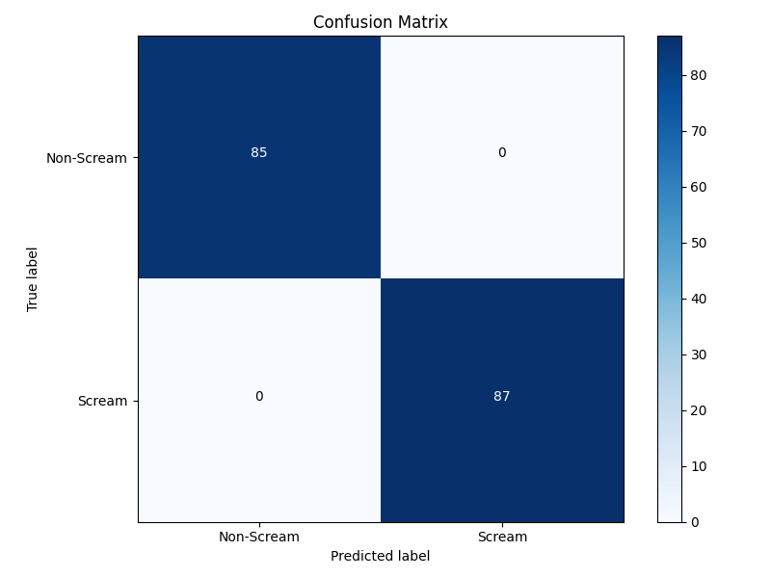
Validation
The following results highlight the model's accuracy in detecting screams under various conditions:
Figure 1.5: Confusion Matrix

Slide 24
Execution Phases
Phase 1: January 13 to February 15
1
Data Preparation and Model Training
2
Phase 2: February 16 – March 1
Working on Alert Mechanism
Phase 3: March 10 – March 31
3
Android App Integration
4
Phase 4: April 1 – April 20
Deployment & Testing

Slide 25
Current Challenges
Background Noise Interference
Hardware Dependency
Power Consumption
Security and Privacy Concerns

Slide 26
Future Enhancements
Battery Life Optimization
Advanced Noise Reduction
Wearable Device Integration
Location-Based Activation

Slide 27
Conclusion
The Scream Detection and Alert System combines machine learning, audio processing, and real-time APIs to improve personal safety. A CNN model trained on public datasets accurately detects screams. Upon detection, the system uses Twilio to alert emergency contacts and Google Geolocation or GPS for precise location tracking. Developed as an Android app with Android Studio and Java, it offers an easy-to-use interface for managing alerts. This project showcases how technology can enhance emergency response and personal security.

Slide 28
References
Saba Nazir, M. A., Malik, S., & Nazir, F. (2018). A Review on Scream Classification for Situation Understanding. International Journal of Advanced Computer Science and Applications (IJACSA), 9(8), 63-75. Available at: https://thesai.org/Downloads/Volume9No8/Paper_9-A_Review_on_Scream_Classification_for_Situation_Understanding.pdf
Saeed, F.S., Bashit, A.A., Viswanathan, V., & Valles, D. (2021). An Initial Machine Learning-Based Victim's Scream Detection in Fire Emergencies. Applied Sciences, 11(18), 8425. Available at: https://www.mdpi.com/2076-3417/11/18/8425
Kumar, A.S., Reddy, M., Akshitha, & Sowmya, G. (2024). Human Scream Detection Using SVM and MLP. Journal of Nonlinear Analysis and Optimization, 15(1). Available at: https://jnao-nu.com/Vol.%2015%2C%20Issue.%2001%2C%20January-June%20%3A%202024/98.15.pdf

Slide 29
References
Mathur, R., Chintala, T., & Rajeswari, D. (2024). Human Scream Detection and Analysis for Controlling Crime Rate. International Journal of Research in Engineering, IT, and Social Sciences, 15(1). Available at: https://www.indusedu.org/pdfs/IJREISS/IJREISS_4399_12524.pdf
Gautam, B., Guragain, A., & Giri, S. (2024). Real-Time Scream Detection and Position Estimation for Worker Safety in Construction Sites. arXiv preprint arXiv:2411.03016. Available at: https://arxiv.org/pdf/2411.03016
Wikipedia - Crime in India - https://en.wikipedia.org/wiki/Crime_in_India
Workplace Violence in the Emergency Department in India, International Journal of Academic Medicine (IJAM) https://journals.lww.com/ijam/fulltext/2017/03020/workplace_violence_in_the_emergency_department_in.6.aspx

